Slide 1
Javascript-Behind the scence

Slide 2
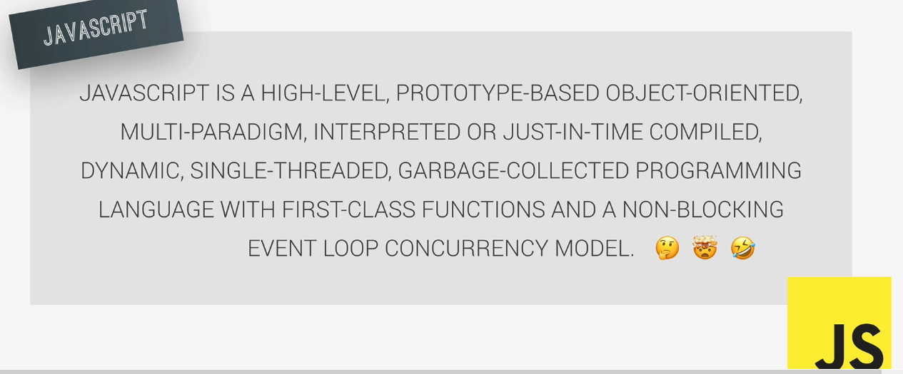

Slide 3
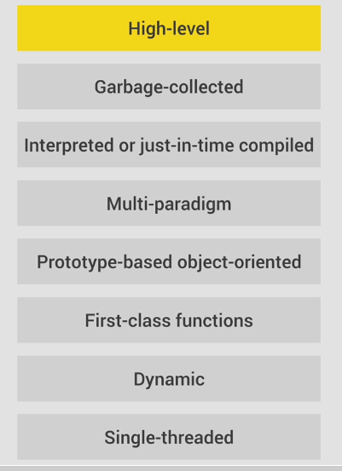

Slide 4
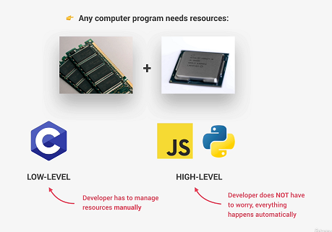
High Level

Slide 5
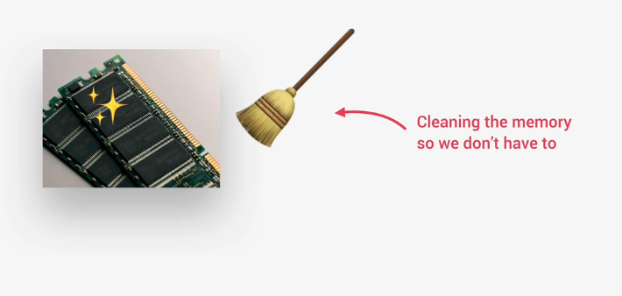
Garbage Collected

Slide 6
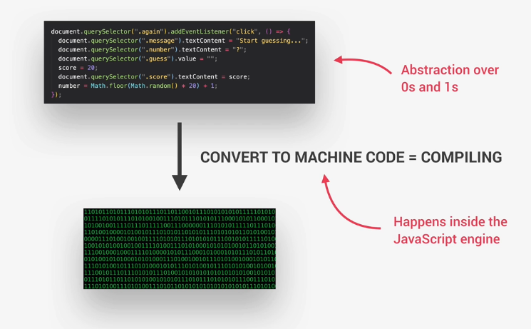
Interpreted – Just-in-time compiled

Slide 7
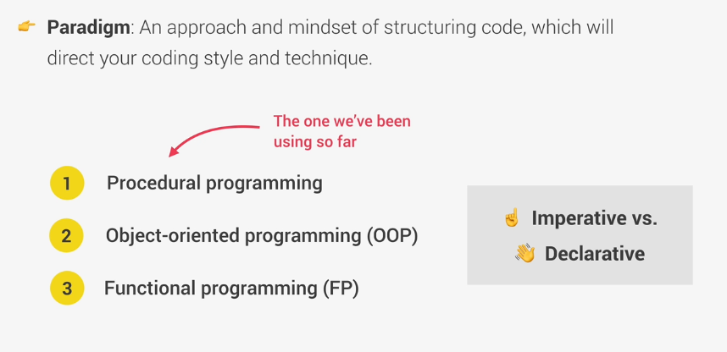
Multi-paradigm

Slide 8
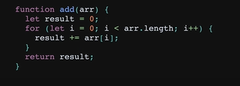
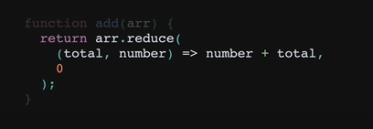
Imperative vs Declarative
Imperative programming
Declarative programming

Slide 9
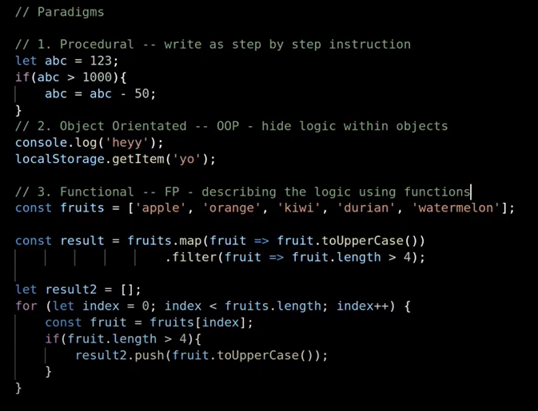
Procedural vs object oriented vs functional

Slide 10
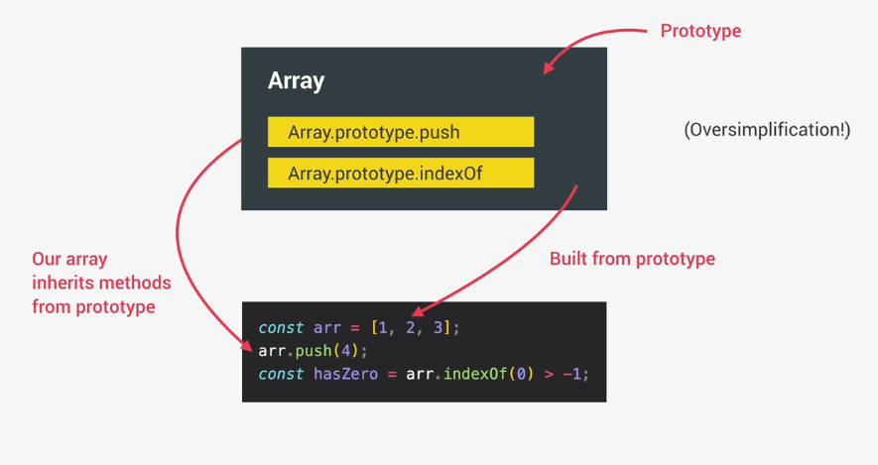
Prototype-based-object-oriented

Slide 11
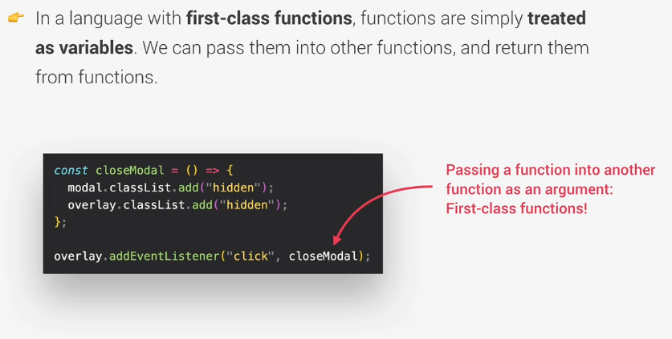
First-class-Function

Slide 12
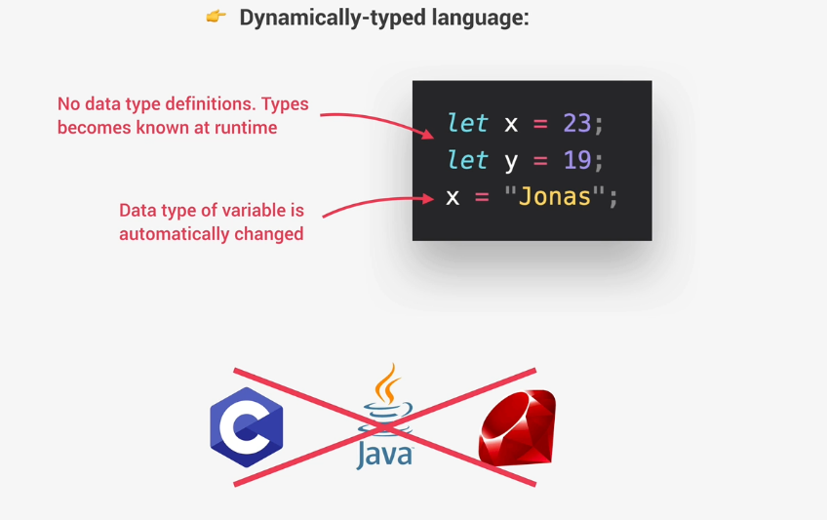
Dynamic

Slide 13
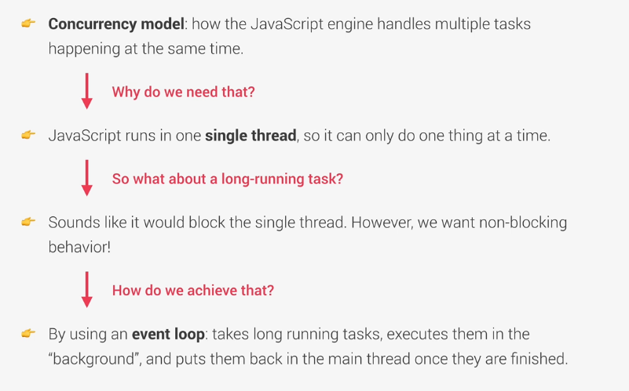
Single Threaded And Non-blocking Event loop

Slide 14
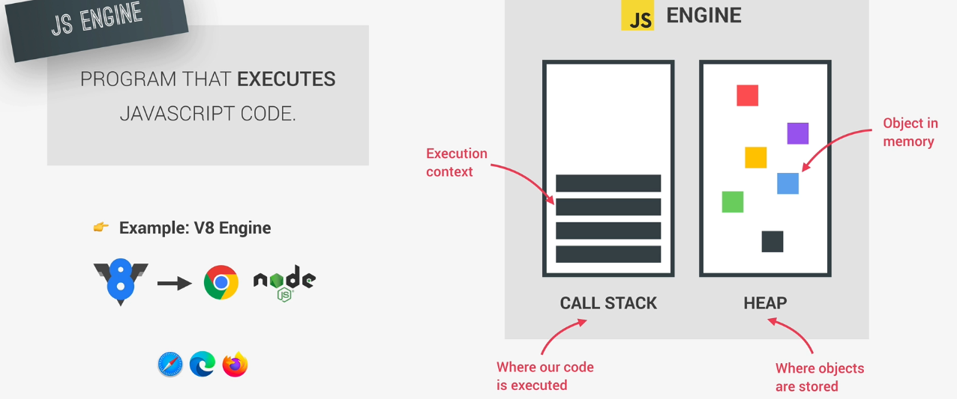
Javascript Engine

Slide 15
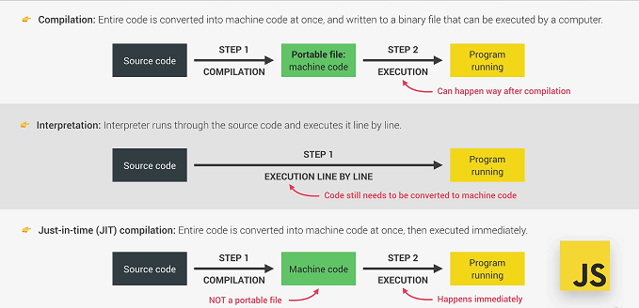
Compilation And Interpretation

Slide 16
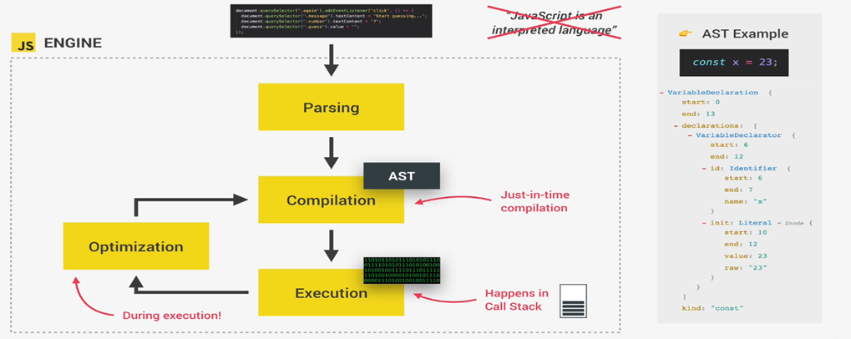
Compilation of javascript

Slide 17
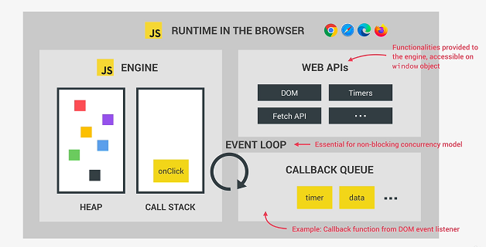
Javascript Runtime

Slide 18
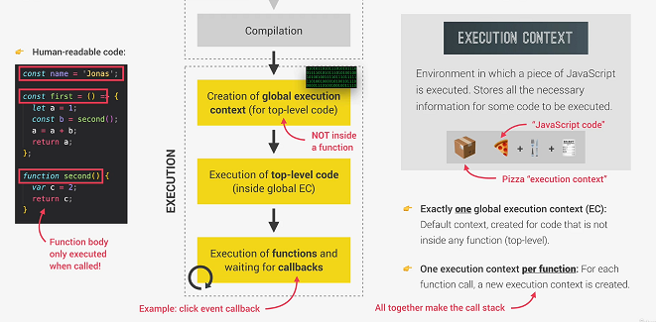
Execution Context

Slide 19
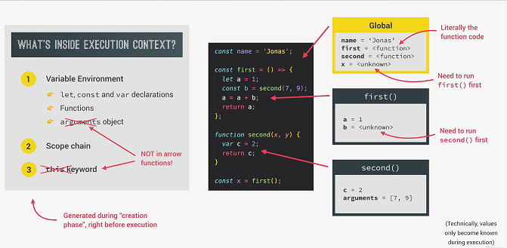
Execution Context

Slide 20
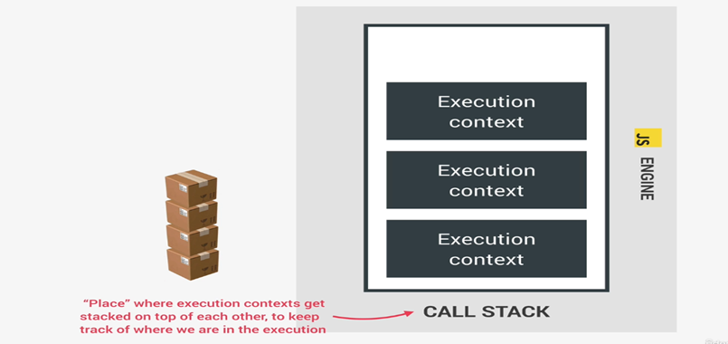
Execution Context – Call Stack

Slide 21
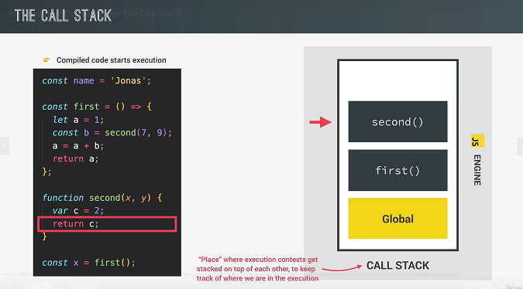
Execution Context : call stack - 1

Slide 22
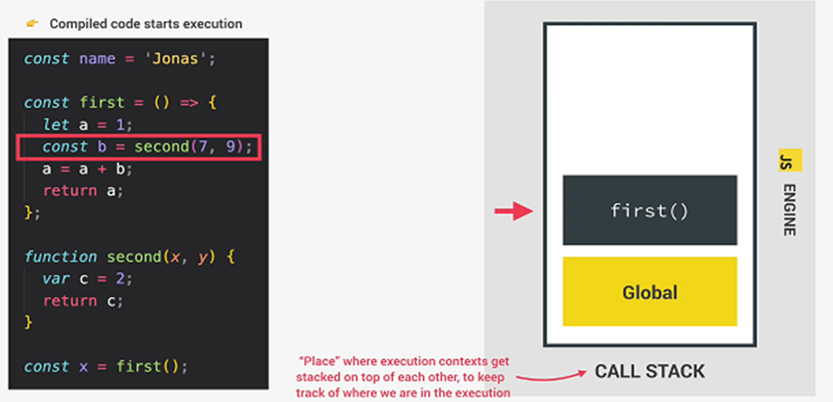
Execution Context : call stack - 2

Slide 23
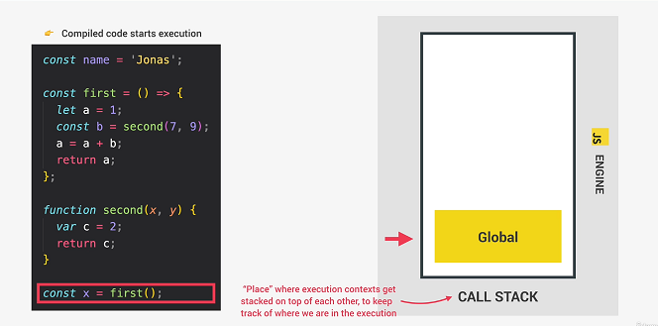
Execution Context : call stack - 3

Slide 24
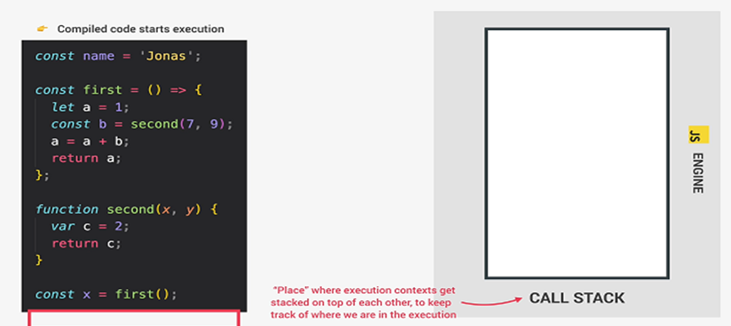
Execution Context : call stack - 4

Slide 25
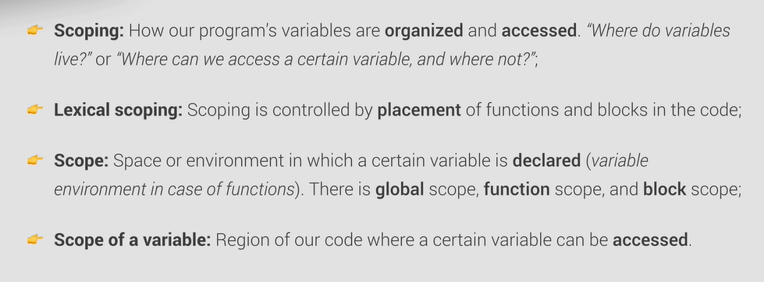
Scope Chain

Slide 26
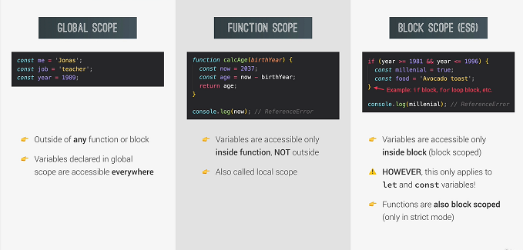
Types of Scope

Slide 27
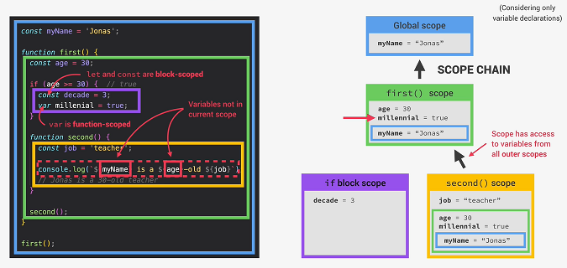
Scope Chain

Slide 28
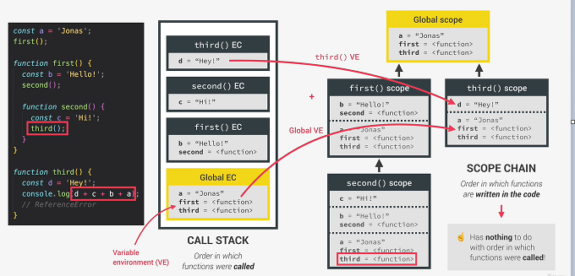
Scope Chain Vs Call Stack

Slide 29
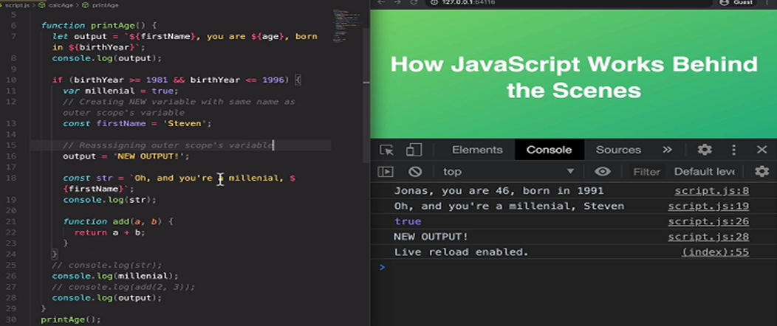
Scope Practice

Slide 30
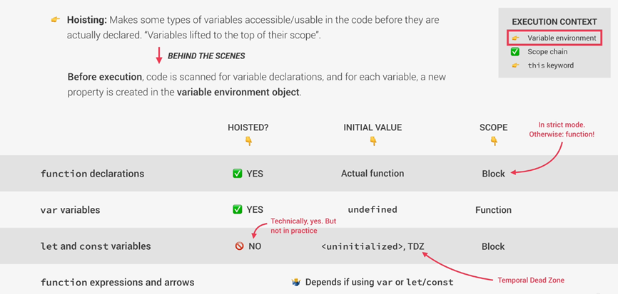
Hoisting

Slide 31
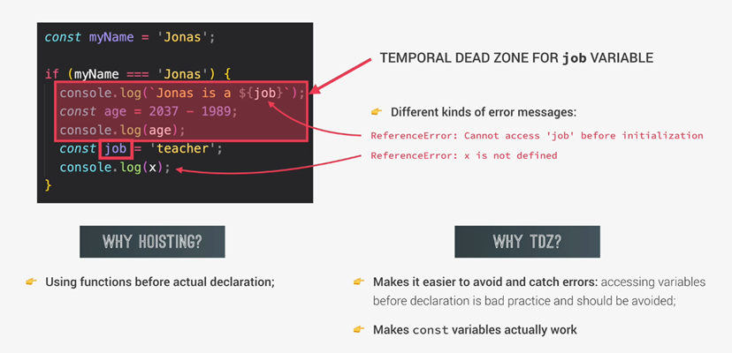
TDZ

Slide 32
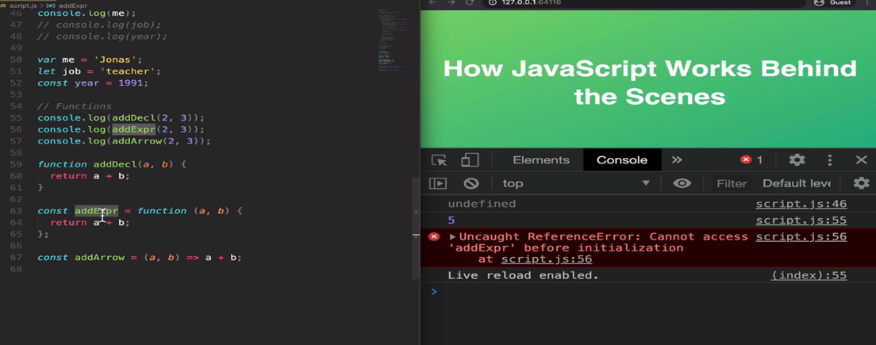
Hositing Practice

Slide 33
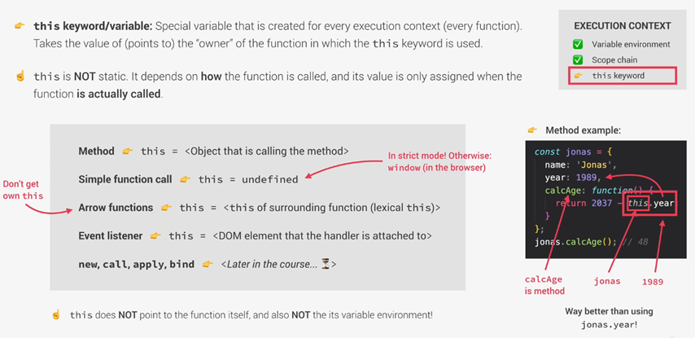
This keyword

Slide 34
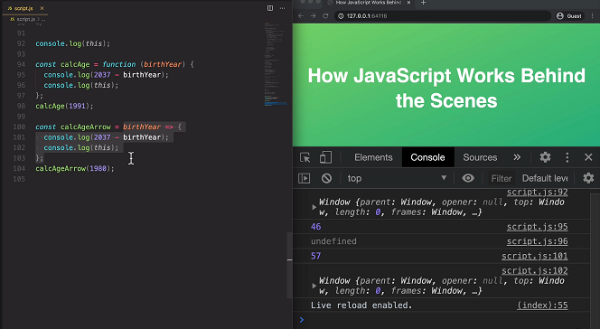
this keyword practice

